Slide 1
Molecular Dynamics Analysis
Yuan Ping

Slide 2
Outline
R. Lesar, Introduction to Computational Materials Science, ch. 6
Thermal averaging: Simple Averages and Fluctuation-Dissipation Theorem
Spatial averaging: Pair Distribution Function
Time averaging: Time Correlation Functions
Analyzing melting
Limitations with time (rare events) and system size.

Slide 3
Thermal averaging: Simple Averages and Fluctuation-Dissipation Theorem

Slide 4
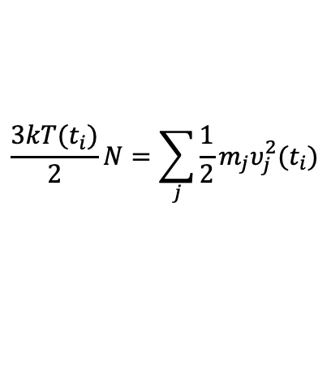
Simple Averages to Get Basic Thermodynamic Variables
Many macroscopic thermodynamic variables are averages over instantaneous versions defined for each microstates
Potential energy
Kinetic energy
Internal energy
Pressure
Temperature
And so on for Volume, Number of atoms, Number of atoms separated by a distance r, …
(see Allen and Tildesley, Leach)
From the Virial Theorem
From the Equipartition Theorem
$$\frac{3kT(t_{i})}{2}N=\sum_{j}{\frac{1}{2}m_{j}υ_{j}^{2}(t_{i})}$$

Slide 5

Averages of Fluctuations to Get Susceptibilities
Susceptibility = response of one macroscopic variable of the system to changing another macroscopic variable
The fluctuation-dissipation theorem relates the response of the system (a susceptibility) to its equilibrium properties (a correlation function)
Equilibrium properties
$$δM=M−〈M〉$$
Specific heat
Compressibility
Magnetic susceptibility
General (A extensive, B intensive)

Slide 6
Spatial averaging: Pair Distribution Function

Slide 7
Pair Distribution Function
The pair (or radial) distribution (or correlation) function. It is the probability of finding particles a distance r apart in the real system relative to the probability for randomly distributed particles.
$$g\left(r\right)=\frac{N}{ρ^{2}4πr^{2}Δr}\left[\begin{aligned}\#Number of times 2 atoms are \\ separated by r^{′}in range r<r^{′}<r+Δr\end{aligned}\right]$$
$$g_{IJ}\left(r\right)=\frac{N}{ρ^{2}4πr^{2}Δr}\left[\begin{aligned}\#Number of times 2 atoms of types I and J are \\ separated by r^{′}in range r<r^{′}<r+Δr\end{aligned}\right]$$
ρ=density=N/V, N=# of atoms, V=volume

Slide 8
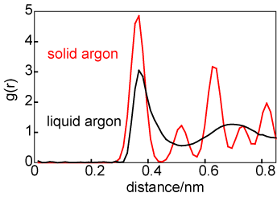
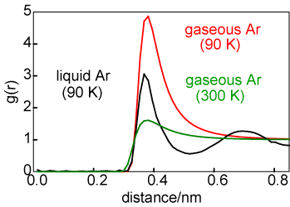
Pair Distribution Ar: Gas, Liquid, Solid
Which one is liquid Ar or solid Ar?
http://rkt.chem.ox.ac.uk/lectures/liqsolns/liquids.html
Gas has no neighbor shells
Liquid has smooth neighbor shells
Solids have sharper neighbor shells

Slide 9
Pair Distribution Ar: Gas, Liquid, Solid
http://rkt.chem.ox.ac.uk/lectures/liqsolns/liquids.html
Gas has no neighbor shells
Liquid has smooth neighbor shells
Solids have sharper neighbor shells

Slide 10
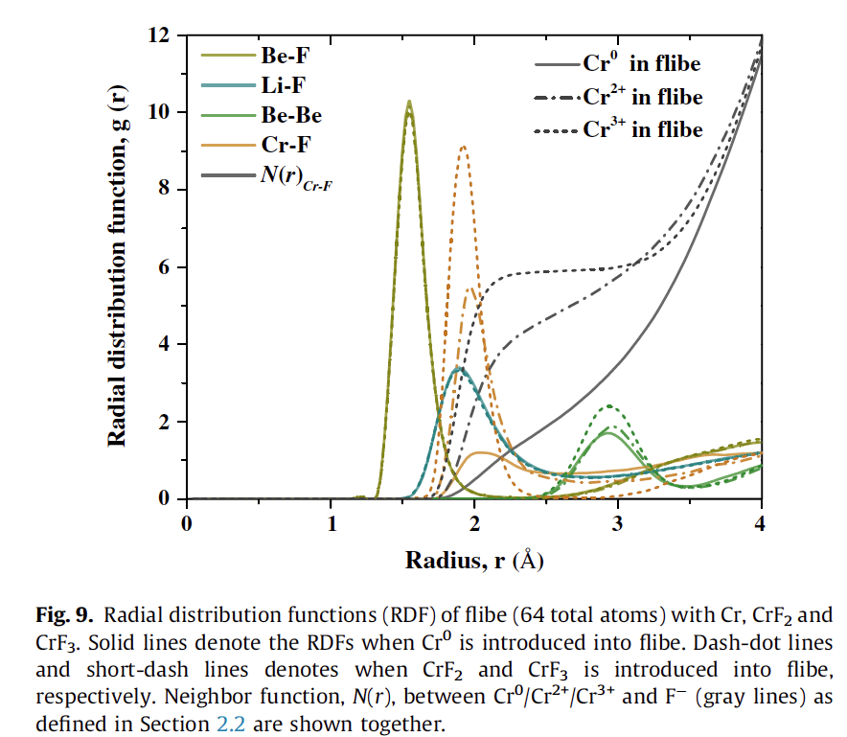
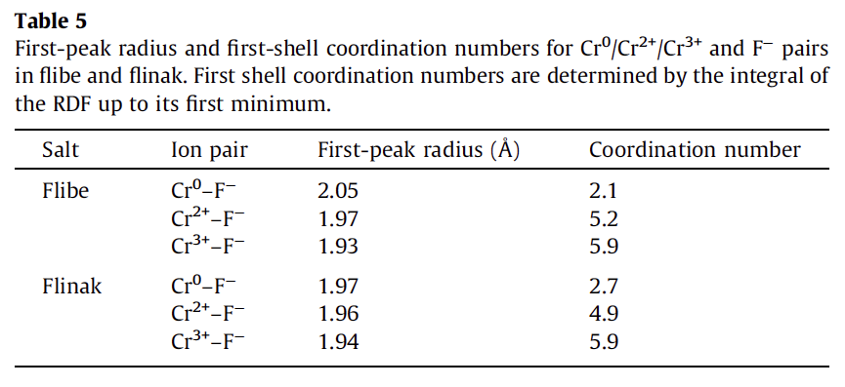
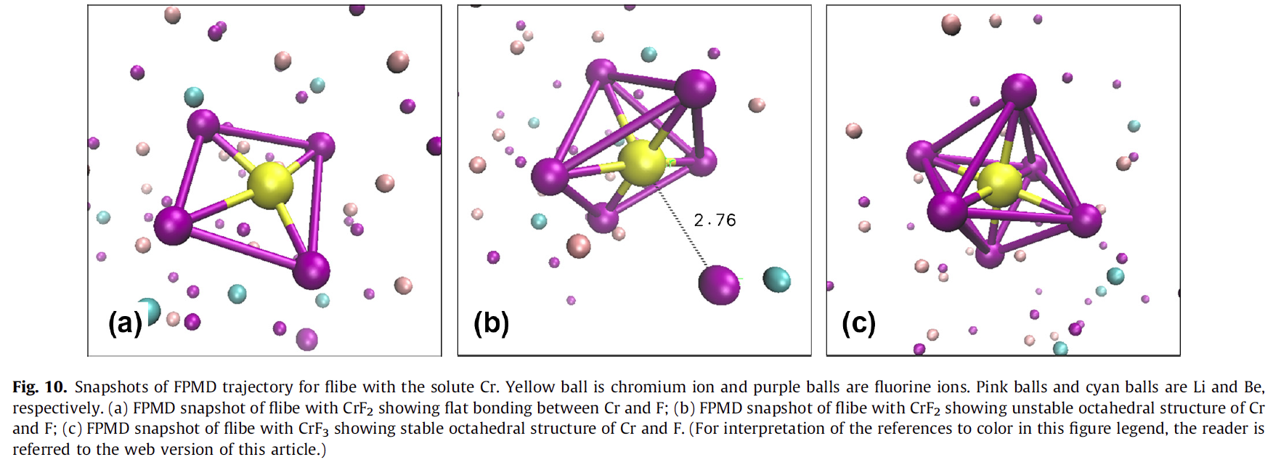
Understanding Cr in FLiBe Salts
Cr can dissolve in salts being considered for nuclear/solar applications
but its structure and properties in the salt are unclear
Nam, et al., JNM ’14

Slide 11
Time averaging: Time Correlation Functions

Slide 12
Averages of Time Correlation Functions to Get Kinetic Coefficients
Kinetic coefficients relate a response to an applied driving force.
This is a generalization of a susceptibility and can be analyzed with a generalization of the fluctuation-dissipation theorem.

Slide 13
Averages of Time Correlation Functions to Get Kinetic Coefficients
Kinetic variables (all simulations done at equilibrium)
Diffusion coefficient
Green-Kubo form
Einstein form
Two forms are formally equivalent but may be easier/harder to implement and may converge differently with time (Einstein is typically faster)
Green-Kubo relationships exist for electrical conductivity, thermal conductivity, viscosity, response to applied fields, mechanical deformations, …
Notes:
The diffusion coefficient is the proportionality between flux J and concentration gradient delta C.

Slide 14
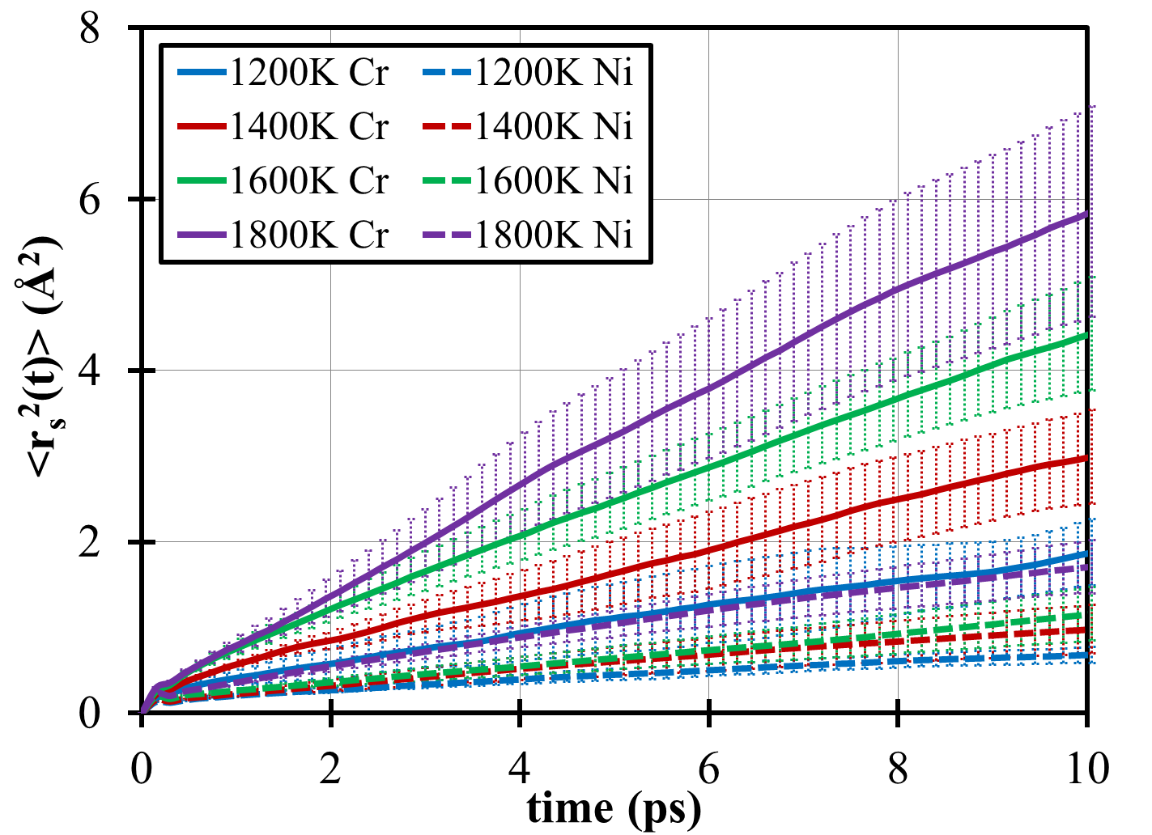
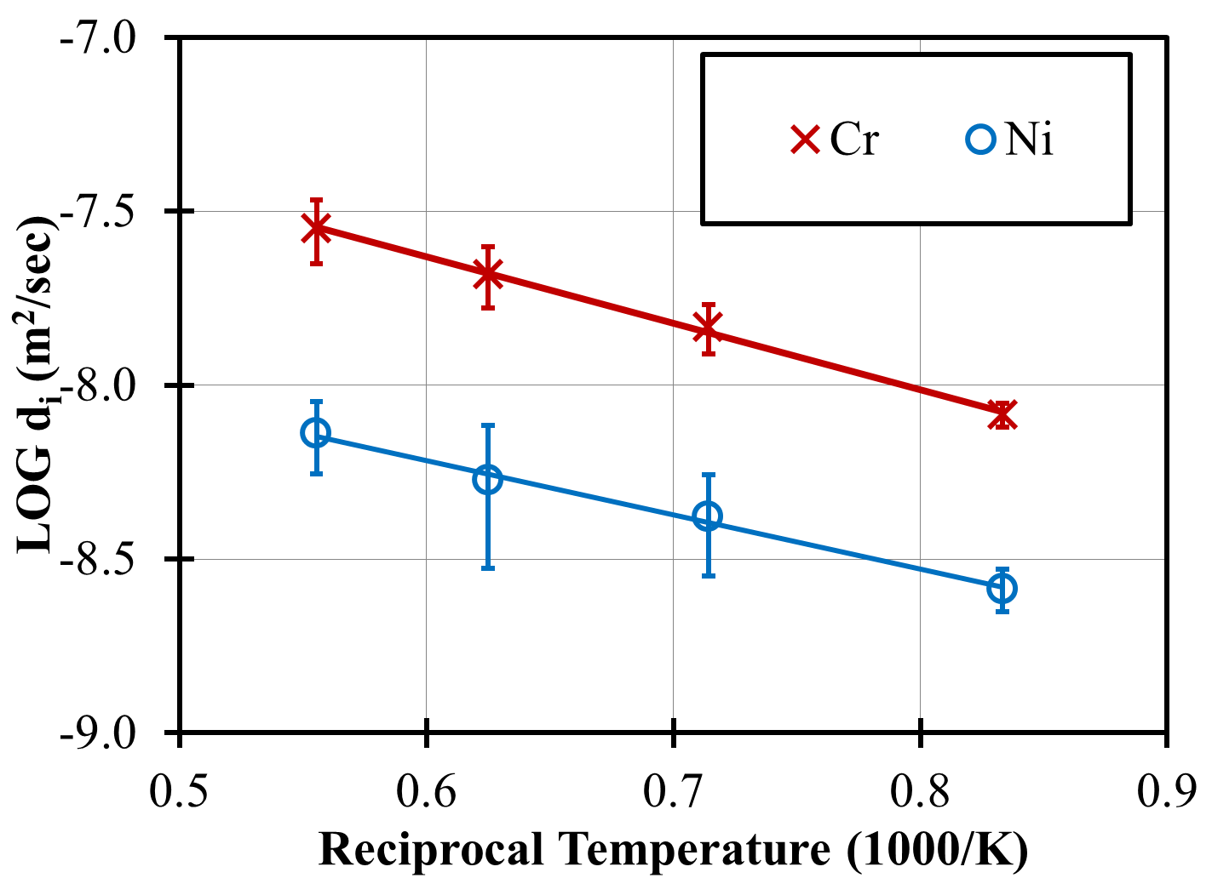
Multiple Origins Average of Diffusion Coefficient
Want diffusivity of Ni and Cr interstitials in Ni-Cr alloys vs. concentration. Ab initio MD modeling.
Get r²(τ) from multiple origin method
Get D from linear fit to r²(τ) (throw away early times <3ps)
Average D over 5 independent simulations and use standard deviation to estimate error bars.
Which line for higher temperature?
Barnard and Morgan, Ab-initio molecular dynamics simulations of interstitial diffusion in Ni-Cr alloys and implications for radiation induced segregation, submitted to J. Nuclear Materials, 2013

Slide 15
Multiple Origins Average of Diffusion Coefficient
Want diffusivity of Ni and Cr interstitials in Ni-Cr alloys vs. concentration. Ab initio MD modeling.
Get r²(τ) from multiple origin method
Get D from linear fit to r²(τ) (throw away early times <3ps)
Average D over 5 independent simulations and use standard deviation to estimate error bars.
Barnard and Morgan, Ab-initio molecular dynamics simulations of interstitial diffusion in Ni-Cr alloys and implications for radiation induced segregation, submitted to J. Nuclear Materials, 2013

Slide 16
Analyzing melting

Slide 17
Example: Melting Temperature (T_{m}) From MD
How can I get T_{m} from an MD simulation?
What physics determines melting?
Which ensemble should I use?
What will I actually calculate that will tell me if the system has melted?
Simple picture: Melting is a solid→liquid transition which occurs when we heat the system up enough that the materials stops being an ordered crystal and the atoms start moving around freely.

Slide 18
Melting
Melting is characterized by
More motion of atoms: So <r²> for atoms should increase a lot at melting
Less regular structure: So spatial correlation function should get much more diffuse, maybe with changes in coordination numbers
New phase with somewhat different density: So we should get a jump in the volume
Latent heat in the transition: So we should see a jump in the total energy
Different specific heat in solid and liquid: So we should see a discontinuity in the specific heat

Slide 19
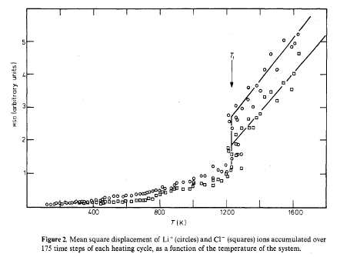
<r2> vs. T for LiCl from MD
Amini, et al, J. Phys. C ‘90
T_{m}
Small displacement in solid – primarily vibrations around lattice sites
Large displacement in liquid – atoms diffuse throughout system

Slide 20
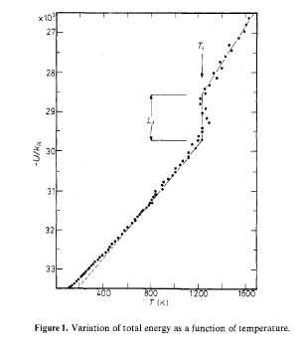
<Total Energy>=<U> vs. T for LiCl from MD
Amini, et al, J. Phys. C ‘90
T_{m}
C_{P}(liquid) = (dU/dt)_{N,P}
≠ C_{P}(solid)
Latent heat of transition
C_{P}(solid) = (dU/dt)_{N,P}

Slide 21
Limitations of MD – Time Scale (Rare Events), System Size
Time Scale (Rare Events)
Typically can run MD on only 10⁻⁹ s (quantum) or 10⁻⁶ (classical) time scale.
“Rare” events occur very infrequently, so do not happen on MD time scales. These cannot be treated with simple MD.
E.g., solid diffusion (D ≈ 10⁻¹² cm²/s) has atom hops only every
≈ 10⁻³ s at room temperature. Cannot see them with normal MD simulations (can use temperature accelerated MD, but that is an advanced topic).

Slide 22
Limitations of MD – Time Scale (Rare Events), System Size
System Size
Time for a simulation scales with number of atoms, ie, O(N) for potentials and O(N²lnN) for quantum simulations, and linearly with total time of simulation, ie, O(t).
Programs can be parallelized to work by spatial decomposition of different regions on different processors.
For potentials this might allow 10⁶ atoms/core * 10³ cores = 10⁹ atoms (I am not sure why only 10⁶ atoms/core but likely run out of memory and time)
For quantum simulations this might allow 5 atoms/core * 100 cores = 500 atoms (more cores gives poor parallelization for most codes)
Can typically treat at most 10³ (quantum) - 10⁹ (potentials) atoms, and increasing, but still limited.

Slide 23
Limitations of MD – Time Scale
Szlufarska and Morgan, Nat. Computations, In prep ‘18

Slide 24
Summary
Thermal averaging: Simple Averages and Fluctuation-Dissipation Theorem
Averaging instantaneous quantities and their fluctuations can yield thermodynamic variables (e.g., energy, specific heat)
Spatial averaging: Pair Distribution Function
Yield key average structural information.
Time averaging: Time Correlation Functions
Yield kinetic parameters (e.g., diffusion coefficient, thermal conductivity)
Analyzing melting
Physical processes like melting can be observed by many probes (energy, volume, atomic displacement, …)
Limitations with time (rare events) and system size.
~10⁻⁹ s (Quantum)-10⁻⁶ s (Classical)
~10³ atoms (Quantum) -10⁹ atoms (Classical)
No “rare” events

